Slide 1

Centre for Development of Advanced Computing
Multiclass classification of visual stimuli on EEG signals from single channel SSVEP-based brain computer interface
Project Guide : Group 3
Miss. Soumya Kushwaha Shankar Patil (220310125005)
Ashish Dalal (220310125016)
Janki Ahirwar (220310125018)

Slide 2
Content
Problem Statement
Solution domain
Introduction
Objective
What is steady-state VEP?
Brain Computer Interface
Is SSVEP good for BCI?
Frequency of brain wave
Project Flow diagram
Python, Machine Learning and tools used
Performance of Classifier
Major finding
Conclusion
References

Slide 3
Problem Statement
The core problem in SSVEP based BCI system is to detect the frequency of the SSVEP component EEG signals because whatever will be the system we are using Cannot process continuous time signals for that we convert continuous time signals to discrete time signals with the help of ML algorithm.

Slide 4
Solution Domain
To achieve possible solution for problem we first analyze the SSVEP BCI based dataset with the help of Machine learning algorithms for best accuracy to build a good Multiclass classification of visual stimuli on EEG signals from single channel SSVEP-based brain computer interface.

Slide 5
Introduction
Brain-computer interfaces (BCIs) provide humans a new communication channel by encoding and decoding brain activities.
This study provides an open dataset, which is collected based on a wearable SSVEP-based BCI system, and comprehensively compares the SSVEP data obtained by wet and dry electrodes .
The collection of electroencephalography (EEG) data from a portable Steady State Visual Evoked Potentials (SSVEP)-based Brain Computer Interface (BCI).
The collection of data was acquired by means of experiments based on repetitive visual stimuli with four different flickering frequencies. The main novelty of the proposed data set is related to the usage of a single-channel dry-sensor acquisition device.

Slide 6
Objective
BCI assists people living with disability to acquire relevant skills and knowledge, diagnose and manage depression, communicate, move and interact socially, as a useful tool to develop applications in the IOT area.
Implementation of different ML algorithm, predicted the possibly of getting the visuals stimuli displayed on the monitor consists of 4 alternating black and white squares with frequency 8.50Hz, 10Hz, 15Hz, 12Hz, respectively. We choose the best algorithm in terms of accuracy

Slide 7
What is steady-state VEP?
Steady state visually evoked potentials (SSVEP) are signals that are natural responses to visual stimulation at specific frequencies.
Steady state visually evoked potentials (SSVEPs) are brain signals that occur in response to a visual stimulus flickering at a fixed frequency.
A rhythmic stimulus can entrain brain activity in the occipital lobe, which is commonly associated with the visual cortex.

Slide 8
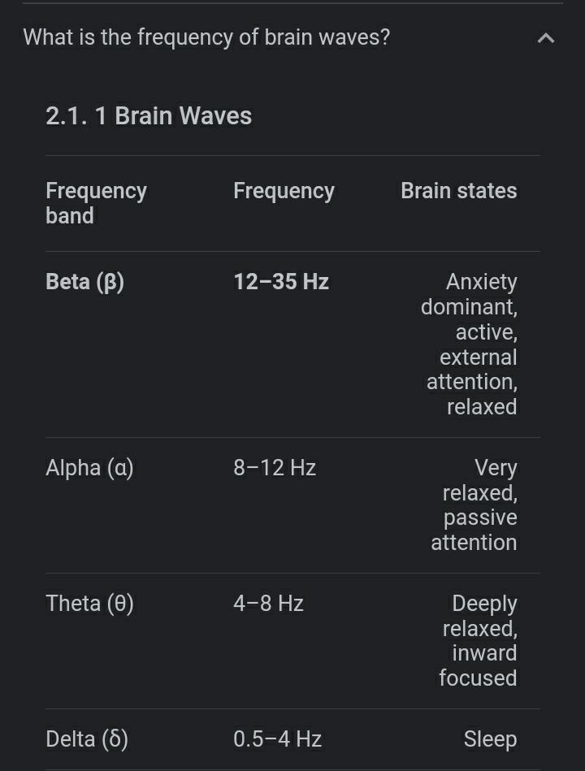
Frequency of brain wave

Slide 9
Brain Computer Interface
Brain-computer interfaces (BCI) are communication systems that allow people to send messages or commands without movement.
BCIs rely on different types of signals in the electroencephalogram (EEG), typically P300s, steady-state visually evoked potentials (SSVEP), or event-related resynchronization.
Allow patients to control a computer by conscious changes of brain activity•
Provide a means of communication to completely paralyses patients: amyotrophic lateral sclerosis (ALS), cerebral palsy, locked in syndrome.

Slide 10
Is SSVEP good for BCI ?
Pros
Does not required training
Comparatively robust toward noise higher information transfer rate(ITR)
Higher signal-to-ratio(SNR) compare to any other EEG signal for BCI
Cons
Limited to certain frequencies
Not comfortable in long use Highly depend on quality of flickering (color, light, etc.)
Also depend on size of stimulus, age and attention of participant

Slide 11
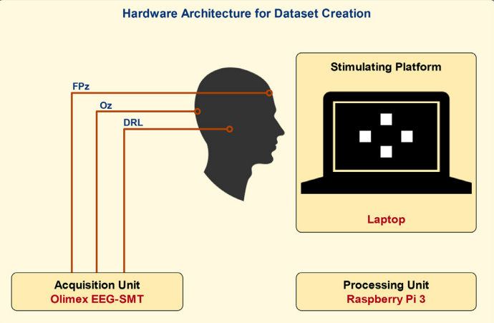
Application flow Diagram

Slide 12
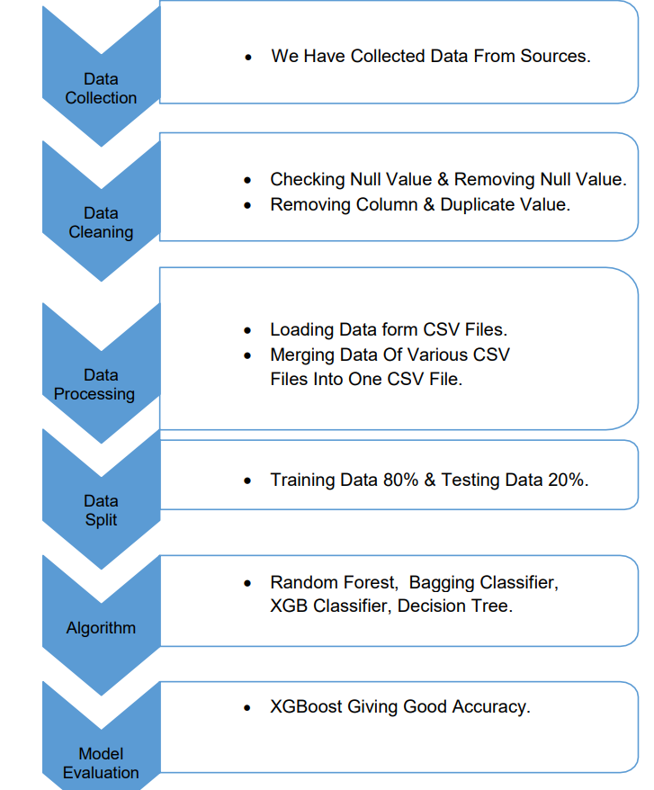
Project flow diagram

Slide 13
Libraries Used
PYTHON
MACHINE LEARNING
NumPy
Pandas
Seaborn
Matplotlib
Scikit
Robust scaler
Recursive Feature Elimination(RFE)
RandomizedSearchCV
GridSearchCV

Slide 14
Model Used
Logistic Regression
Random Forest
Bagging Classifier
Decision Tree classifier
XGboost Classifier.

Slide 15
Tools Used
Statistical Tools
Software Tools
Exploratory Data Analysis :
Descriptive statistics , Bar charts
Machine Learning Algorithms (Data Mining Classifiers):
Logistic Regression,
Random Forest,
Extra trees classifier,
Bagging Classifier,
Decision Tree classifier.
Validation Techniques:
K-cross validation
PYTHON
MS-EXCEL
JUPYTER NOTEBOOK

Slide 16
Performance of the above Classifier Observations: Out of the above only XGboost classifiers gives us more accuracy. Now we use only XGboost model for further also try the Recursive Feature Elimination method to achieve good accuracy.
Model Name | Testing Accuracy
XGBoost Classifier | 0.55
Logistic Regression | 0.44
Random Forest | 0.22
Extra trees classifier | 0.11
Bagging Classifier | 0.44
Decision Tree classifier | 0.15

Slide 17
Recursive Feature Elimination Observations: The above tables show the accuracy corresponding with No. of features. Here we can see that as we take more features for model building it gives better accuracy. For 4000 features XGboost gave us 56% of accuracy.
No. OF Features | Testing Accuracy with XGBOOST Classifiers
4000 | 0.56
3000 | 0.44
2000 | 0.33
1000 | 0.22

Slide 18
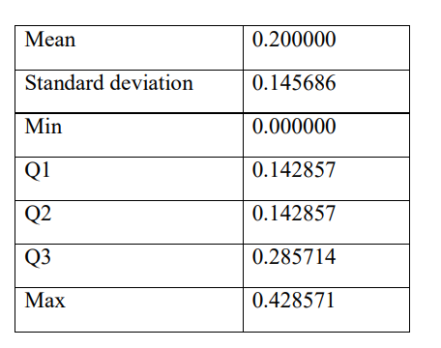
K-cross validation Interpretation: 68% of predicted values are correctly classified with 32% misclassification rate by the Decision Tree classifier. The average accuracy is 58%. Observations: From the above output of cross-validation we can see that the standard deviation between scores is high. Because of that every time it gives us different accuracy.so we can say still XGboost giving good accuracy but variance of accuracy is high which is not good for us. Major Finding

Slide 19
Major Finding
We have applied machine learning algorithms such as logistic Regression, Random Forest, Extra-tree classifier, Bagging classifier, Decision tree classifiers, XGboost classifier without any model improvement.
Then we used RFE with XGboost model, in that we have seen XGboost model gives better result with number of features= 4000.
Again, for finding best parameter we used Randomized search cv method for XGboost, then we get an improved accuracy = 67%.
Finally for model validation we have used K-fold cross validation, after that we have seen standard deviation of the accuracy score is very high (i.e., variability of the score is very high) and because of that whenever we will fit the model by using best parameter it will give us deviated accuracy scores.
Limitations:
With result of Cross- validation, as in this project we have less amount of data (row = 44, features = 4096) because of that model gave us train data accuracy = 100%, test data accuracy = 66%. this scenario is clearly showing problem of overfitting.
To overcome this overfitting problem, we should collect more data subjects

Slide 20
CONCLUSION
SSVEP is a good choice for BCI applications due to no training requirements.
SSVEP based-BCIs need higher performance with high ITR.
Unified standard in data representation could overcome the gap between machine learning research and cognitive neuroscientist.
(accuracy define ) all algorithm to make conclusion large.

Slide 21
References
G. Acampora, P. Trinchese, A. Vitiello, Applying logistic regression for classification in single-channel SSVEP-based BCIs, in: Proceedings of the IEEE International Conference on Systems, Man, and Cybernetics, 2019.
A.M. Norcia, L. Gregory Appelbaum, J.M. Ales, B.R. Cottereau, B. Rossion, The steady-state visual evoked potential in vision research: a review, J. Vis (2015)
D. Anwar, P. Garg, V. Naik, A. Gupta, A. Kumar, Use of portable EEG sensors to detect meditation, in: Proceedings of the International Conference on Communication Systems & Networks (COMSNETS), Bengaluru, 2018.
H. Hinrichs, M. Scholz, A.K. Baum, et al., Comparison between a wireless dry electrode EEG system with a conventional wired wet electrode EEG system for clinical applications, Sci. Rep. 10 (2020).
M. Ogino, S. Kanoga, M. Muto, Y. Mitsukura, Analysis of prefrontal single-channel EEG data for portable auditory ERP-based brain–computer interfaces, Front Hum. Neurosci. 13 (2019).
S.J. Johnstone, R. Blackman, R., J.M. Bruggemann, EEG from a single-channel dry-sensor recording device, Clin. EEG Neurosci (2012) 112–120.
V. Odom, M. Bach, M. Brigell, G.E. Holder, D.L. McCulloch, A.P. Tormene, Vaegan, ISCEV standard for clinical visual evoked potentials (2009 update), Documenta Ophthalmologica (2010).
H. Cecotti, I. Volosyak, A. Graser, Reliable visual stimuli on LCD screens for SSVEP based BCI, in: Proceedings of the European Signal Processing Conference, 2010

Slide 22
Thank you

